Slide 1
3D Slicer Overview

Slide 2

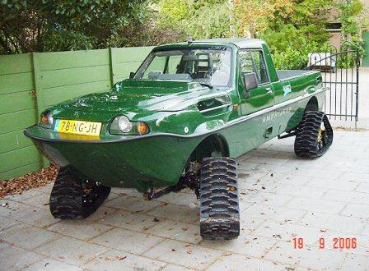
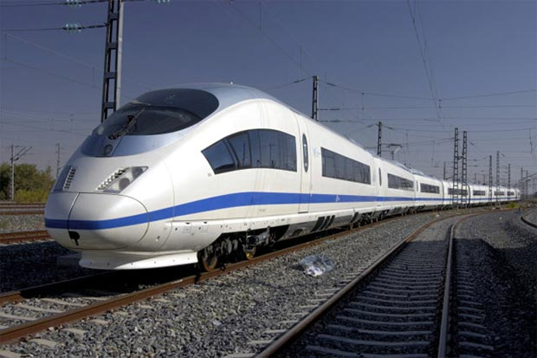
Right tool for the job
Technological prototype
Research tool
Clinical tool
Can it be done?
Innovative, not robust, usually single developer supported
Should it be done?
Robust and usable enough for clinical evaluation, flexible, open, portable, community supported
Patient ready
FDA approved, company supported, closed source
Jalopnik.com
www.unusuallocomotion.com
www.senkox.com
Notes:
The steps, from a technological prototype, to a tool, ready for the clinic, often passes through the following thought process:
1. For the technological prototype you ask yourself: Can it be done? -> Innovative, not robust, usually single developer
2. In the second stage, when your protoype will be used in biomedical research: Should it be done? -> Usability, robustness, portability and openness
3. Finally, at the clincial stage, when your intial prototype has passed through the research stage. -> FDA approved, supported, closed source

Slide 3


Without an application platform
Building on an application platform
Each application is developed from ground up
Completely new software is developed for each problem/procedure/device
Significant work is needed to integrate new, advanced algorithms
Core functionalities are already implemented
New software modules can be developed for specific needs
Many new, advanced algorithms are available
Well-supported with a large user and developer community
Quick start.
Huge waste of time, money, and effort overall.
Investment at the beginning: learning.
Minimal wasted efforts.
Notes:
Because, without an application platform
Show animations
On the other hand, if you are building your work on a pre-existing application platform
1. Portable (Win, Linux, Mac), Open-source

Slide 4


3D Slicer platform overview
Slicelets
(custom Slicer applets)
LumpNav
...
ProstateNav
DICOMweb REST API
SlicerIGT
Breach warning
Slicer extensions
Pivot calibration
Model registration
...
Tool watchdog
...
Slicer VirtualReality
SlicerJupyter
SlicerWeb
3D Slicer
Visualization
Registration
Segmentation
...
Quantification
Python, VTK, ITK, CTK, Qt, DCMTK, …
OpenIGTLink
DICOM
PLUS
OpenIGTLink
Calibration, synchronization, pre-processing, simulation, record&replay
Device interface
software
hardware
Surgical microscopes, endoscopes
Ultrasound
scanners
Navigation
systems
Robotic devices, manipulators
MRI, CT, PET scanners
hundreds of devices (imaging, position tracking, various sensors, and manipulators)
Notes:
Using OpenIGTLink (which is a Network Interface for Image-Guided Therapy), PLUS can stream this data in real-time to 3D Slicer and can also be used for pre-processing, and calibration for navigated image-guided interventions.

Slide 5
Building on a platform

Slide 6
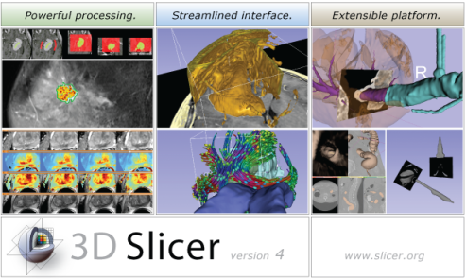



Background for 3D Slicer
Software application for medical image computing: data import/export, visualization, segmentation, registration, quantification, real-time guidance
Application framework: customizable, extensible custom modules
Completely free (BSD)
Multi-platform
User and developer support
Training courses, documentation, tutorials
Fedorov, et al. "3D Slicer as an image computing platform for the Quantitative Imaging Network." Magnetic resonance imaging 30.9 (2012): 1323-1341.
Notes:
Valley of death: Slicer does not fit traditional science funding mechanisms:
Science agencies: its not innovative
Companies: no proven clinical utility, too risky

Slide 7
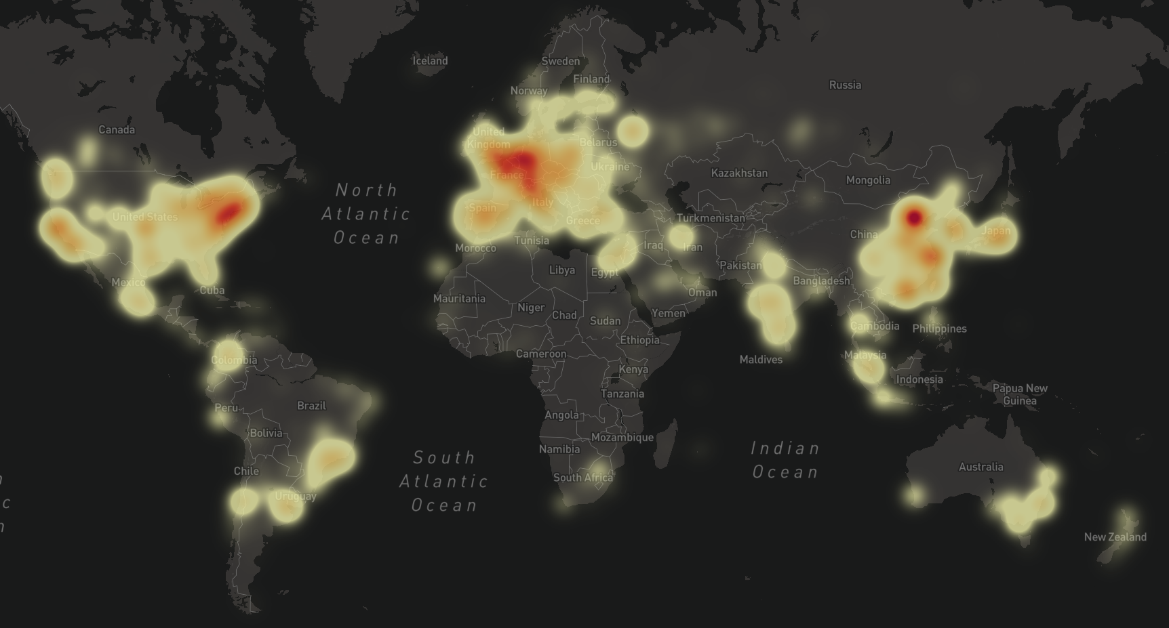
Large user community
500 downloads per week in 2012
3700 downloads per week in 2022
770 000+ downloads over the past 5 years:
Notes:
And as you can see, Slicer has a similarly sized user base here in Europe as in North-America.

Slide 8

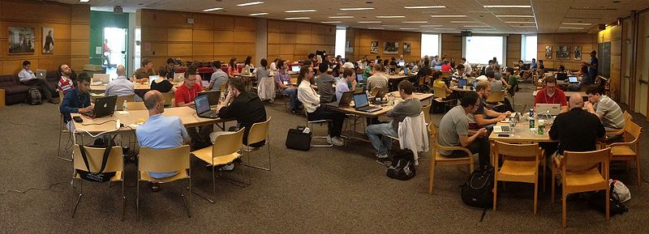
Project week
Twice a year
Bring your own project, work with experts
Meetings, training
Upcoming: Summer 2022, virtual event
https://projectweek.na-mic.org/
Notes:
And as you can see, Slicer has a similarly sized user base here in Europe as in North-America.

Slide 9
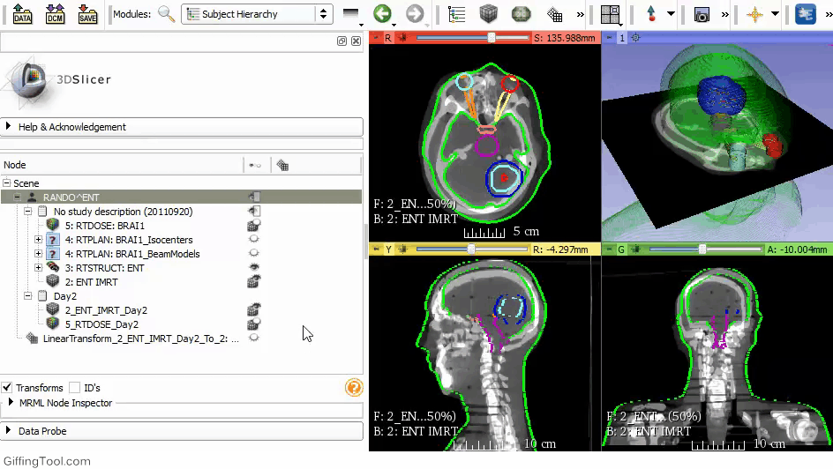
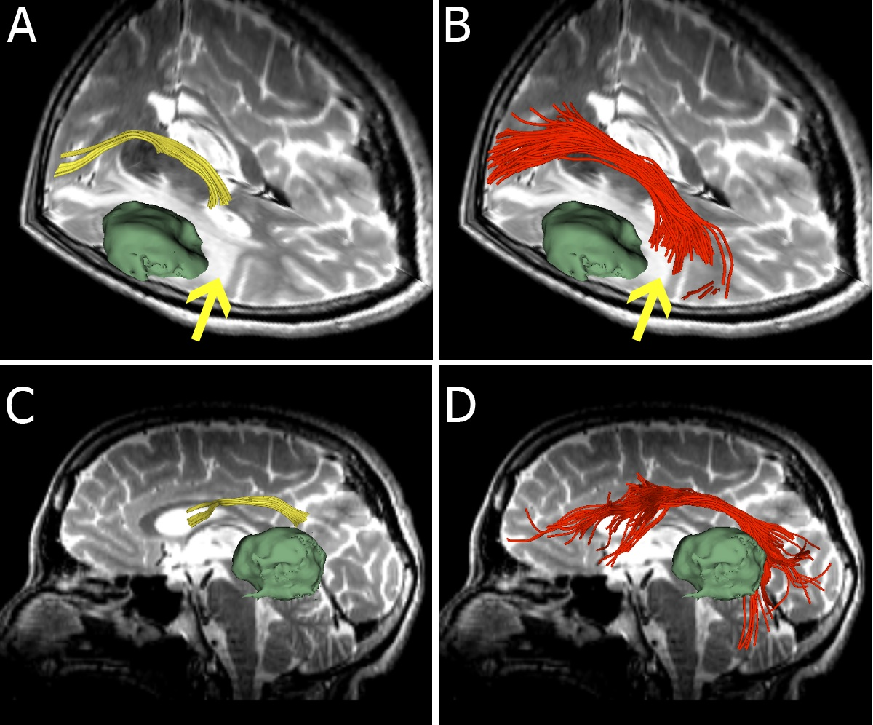
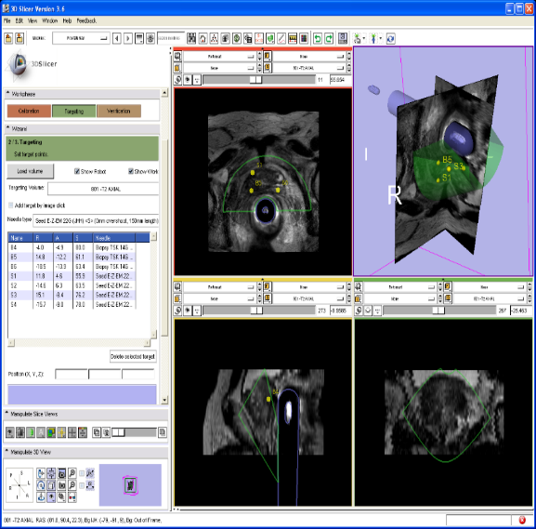
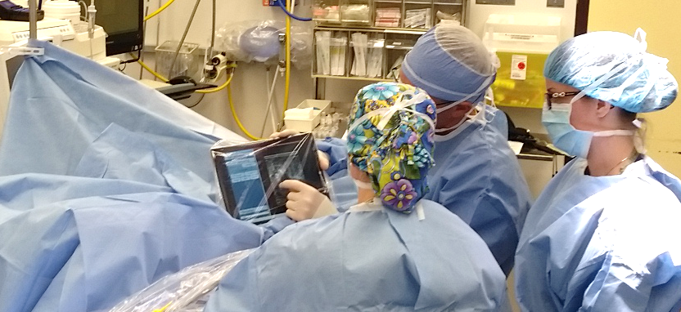
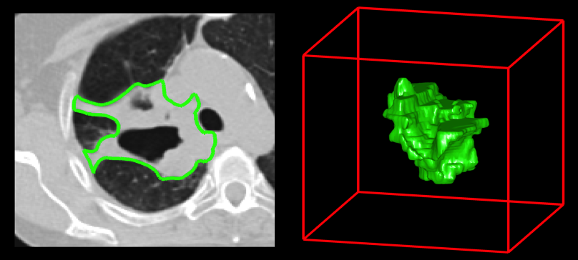
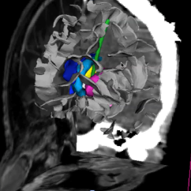
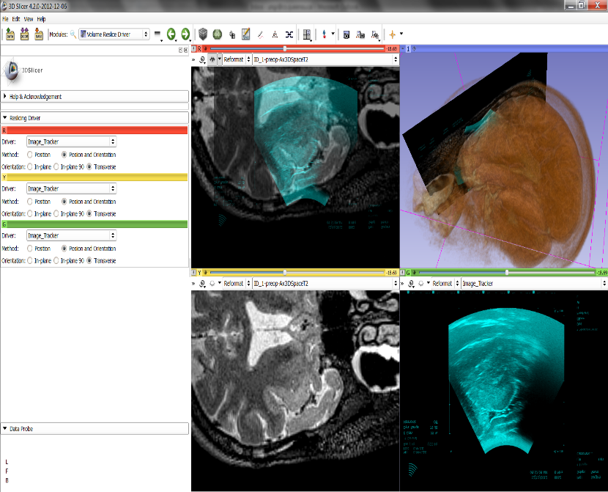
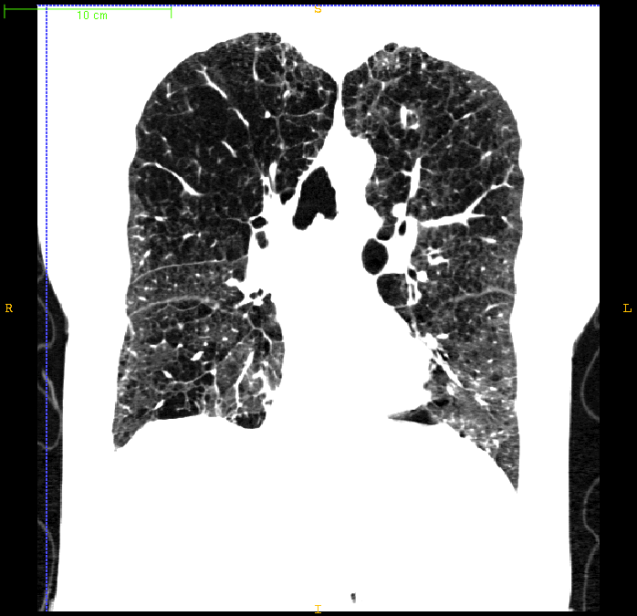
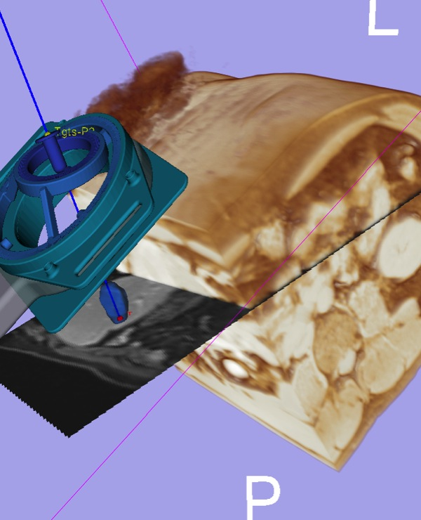
3D Slicer in clinical use
Radiation dose calculations
MRI-guided prostate biopsy
Tracking peritumoral white matter fibers
Breast cancer surgery guidance
Diagnosis of Different Tumors in Lung Cancer
Clinical users drive creation of technology
Diagnosis of Osteoarthritis Degeneration
Model-Guided Deep Brain Simulation
Quantitative assessment of COPD
Brain surgery
Surgical navigation
Notes:
Thanks to 3D Slicer clinical users can drive creation of technology (including the mandatory engineer in the clinic, obviously :). And Slicer is used in a large number of research projects.
MRI-guided prostate biopsy
-Used on 60+ patients at 3 clinical sites (Harvard Brigham and Women’s Hospital, Johns Hopkins Hospital, NIH National Cancer Institute).
-MR imaging, Custom needle positioning device, 3D Slicer with ProstateNav module
Brain surgery
-Real-time data from BrainLab navigation system and Zeiss Pentero stereo surgical microscope
-Tracked microscope video feeds recorded and visualized in real-time in 3D Slicer
-Tracked US through the dura after opening the cranium, overlay of MR/US shows brain shift
LumpNav
-More at the end of this presentation

Slide 10
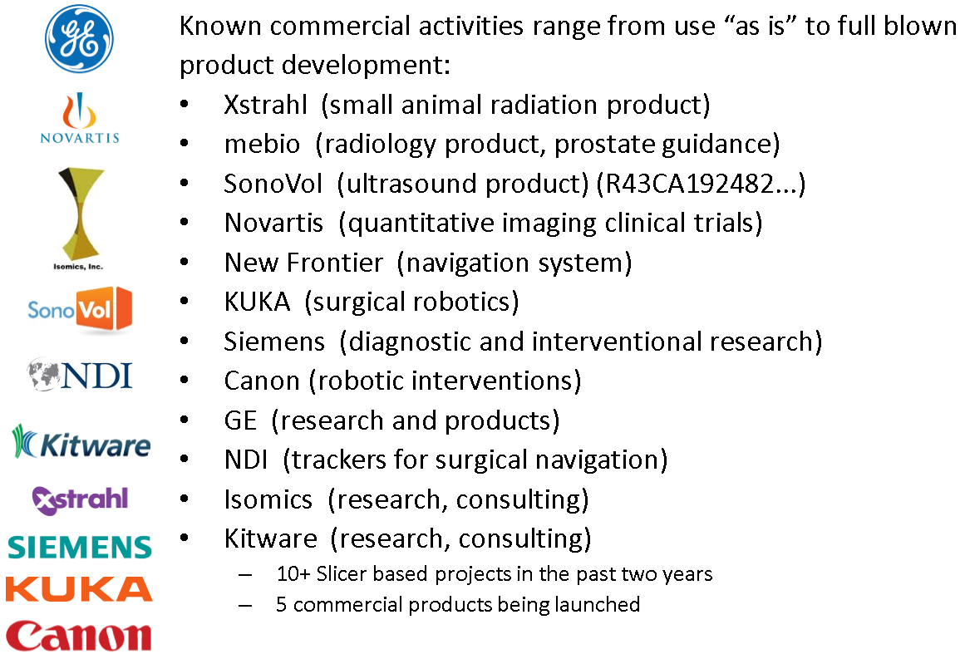
Commercial use

Slide 11
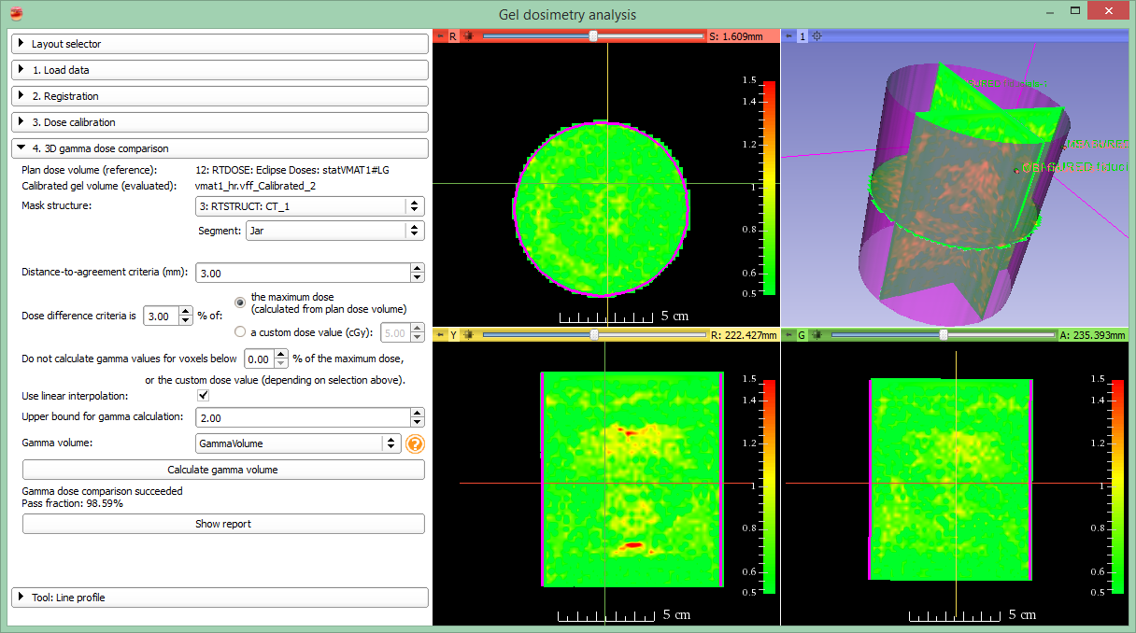
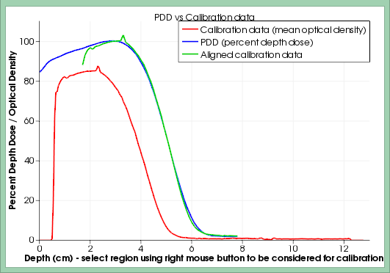
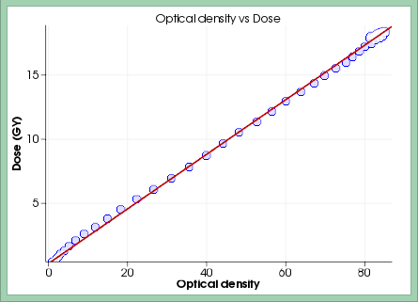
Example: Gel Dosimetry tool
https://www.slicer.org/slicerWiki/index.php/Documentation/Nightly/Modules/GelDosimetry

Slide 12
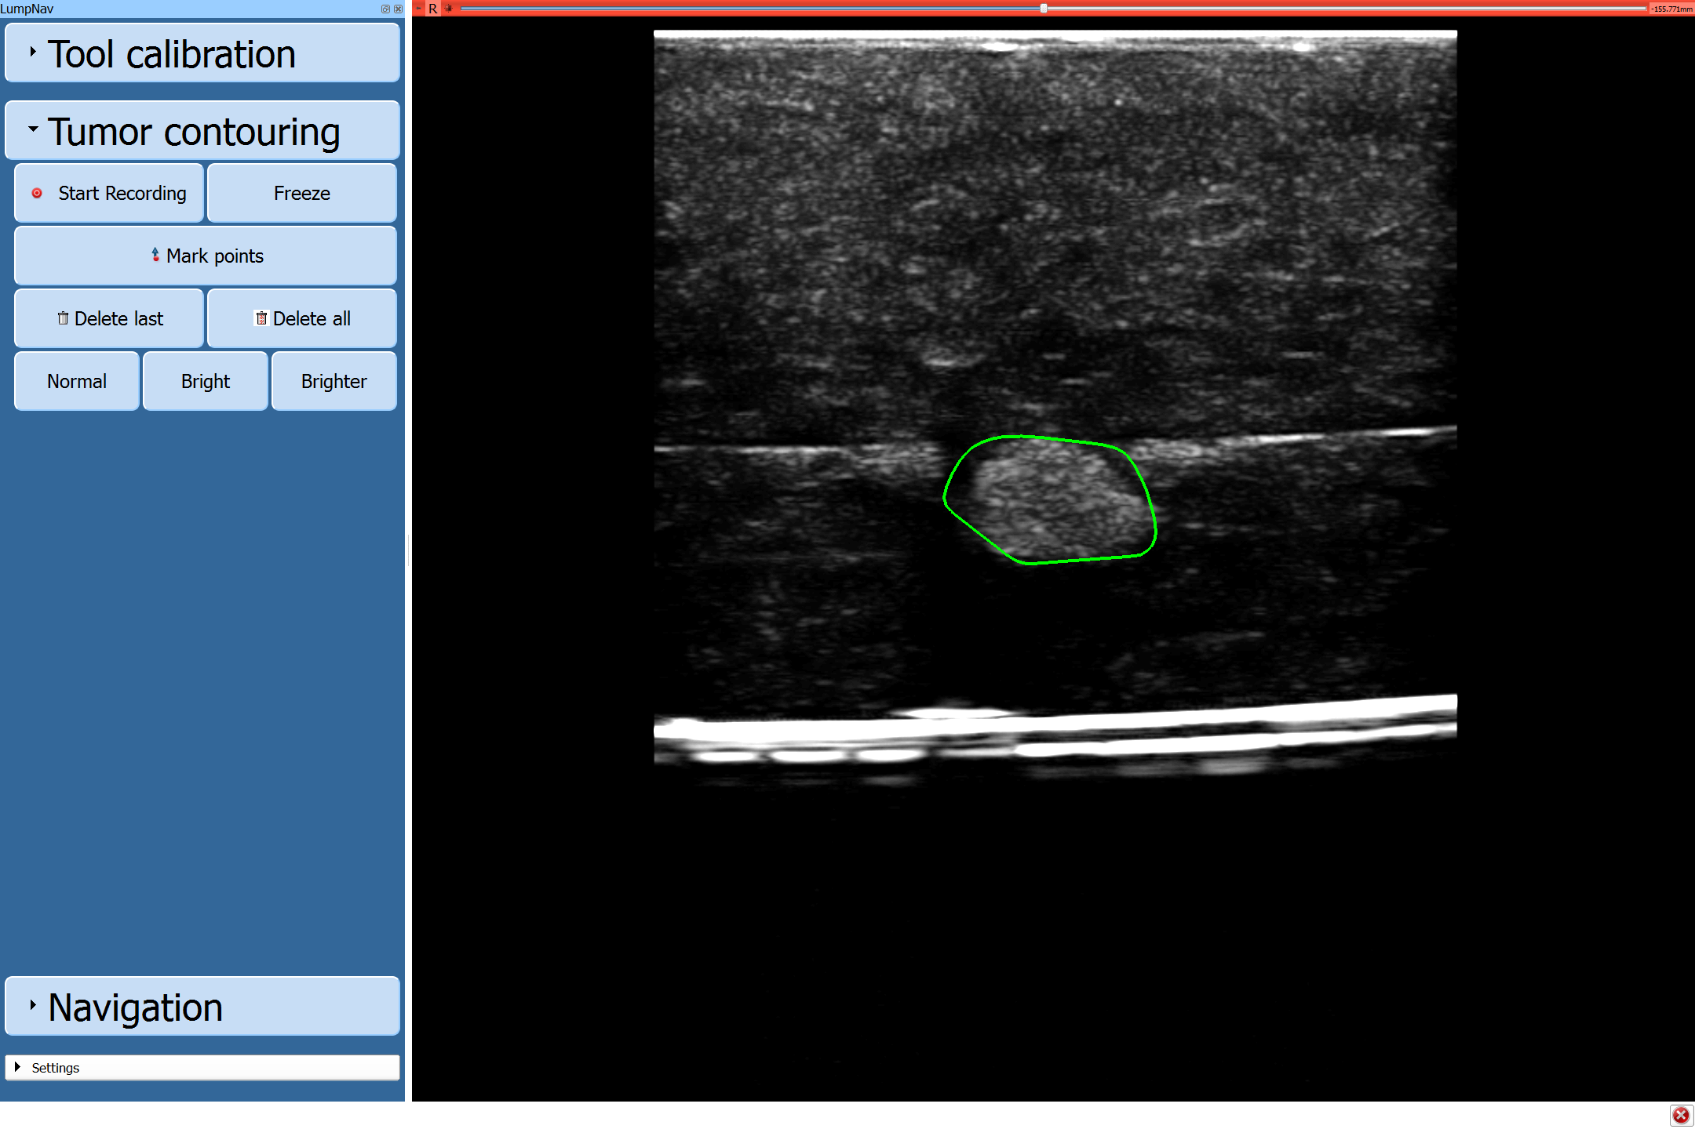
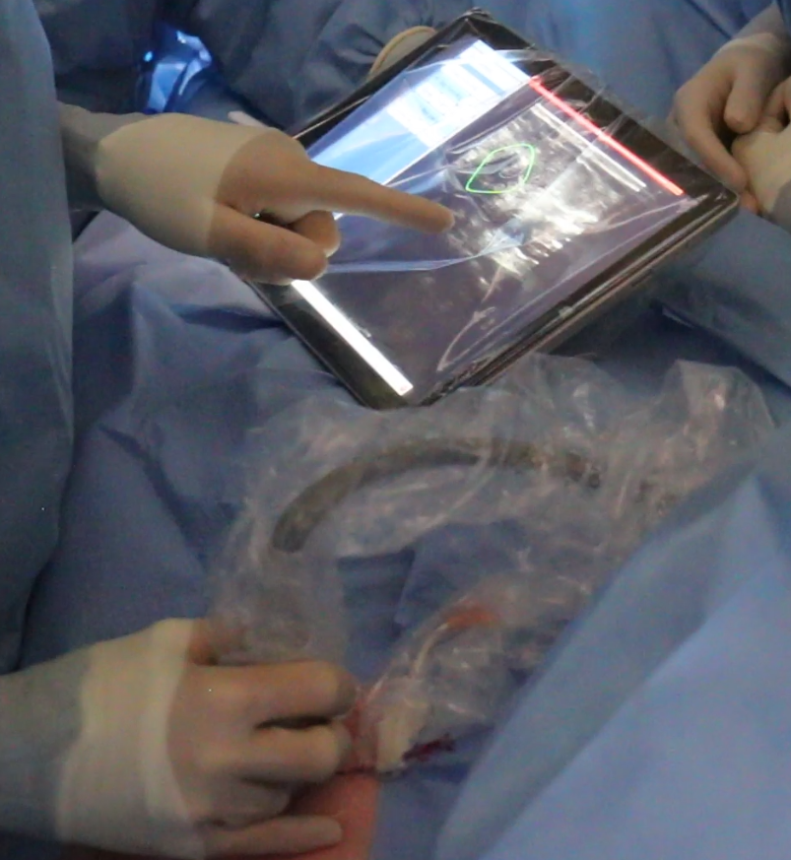
Example: LumpNav (touch optimized)
https://youtu.be/90l0T1ADe_Y?t=55
http://www.slicerigt.org/wp/breast-cancer-surgery/
Chosen option: “simplified main window”

Slide 13
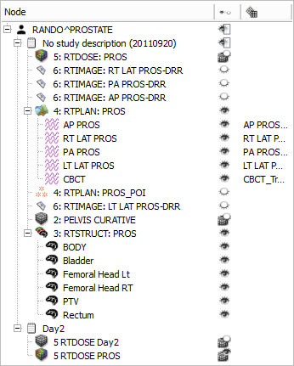
Data import/export
DICOM: 2D/3D/4D volumes, structure sets, dose volumes, etc. (extensible without Slicer core changes)
Research data formats for volumes, meshes, transforms (NRRD, MetaIO, VTK, HDF, etc.)
Common non-medical data formats (JPEG, TIFF, etc.)
Save and complete restore of application state
Notes:
Slicer supports many ways of importing and exporting data that one wants to visualize:
1. Through the DICOM (is a standard for handling, storing, printing, and transmitting information in medical imaging.) importer (which supports … )
2. Common research data formats
3. Basic data formats
Additionally, it is also possible to, at anytime, save the entire application state in order to restore the complete application state at a later time. (US ELEPHANT DEMO?)

Slide 14
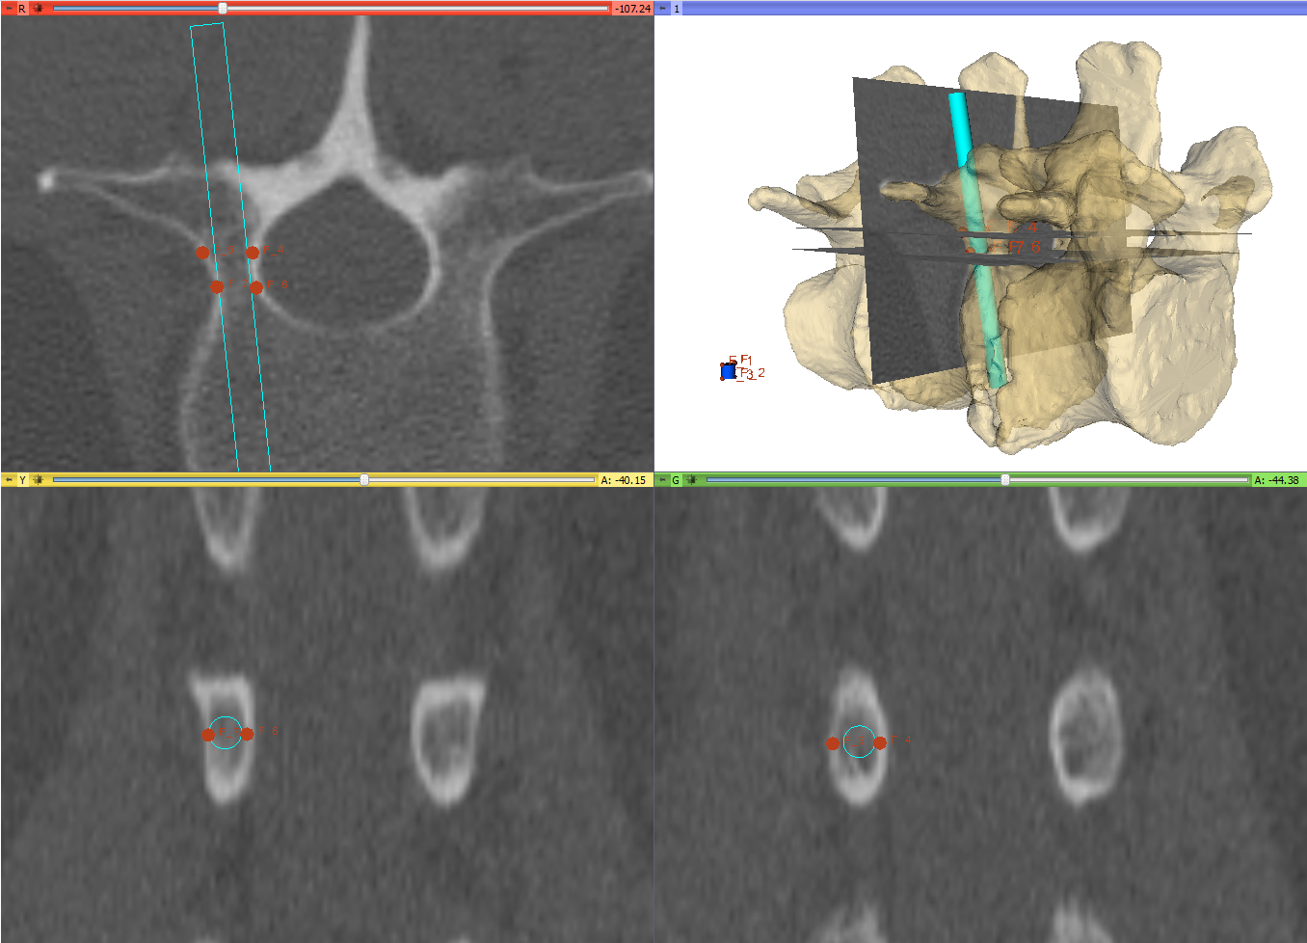
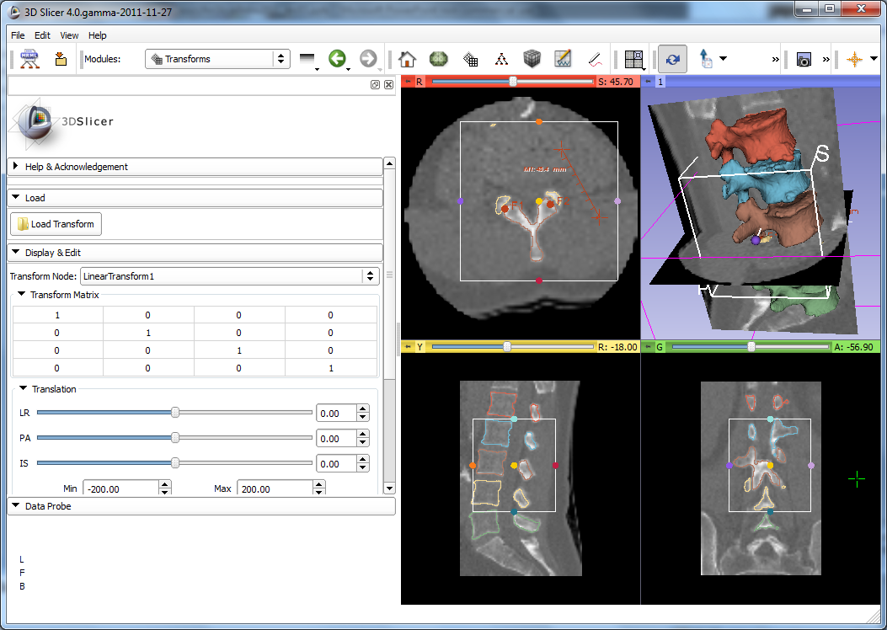
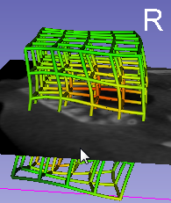
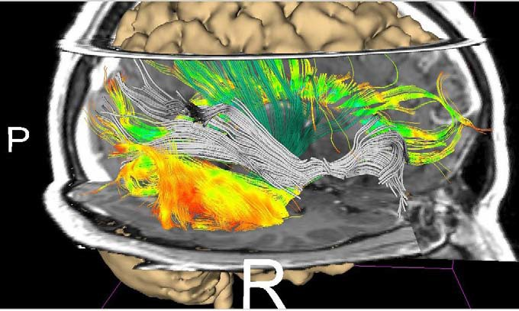
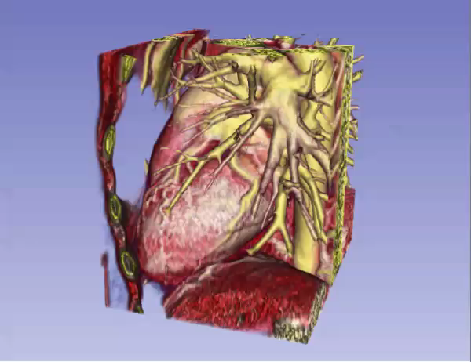
Visualization
2D (slice) and 3D views, chart views
Configurable layout
Multi-modality image fusion (foreground, background, label map)
Transforms, vector and tensor field visualization
Surface and volume rendering
Time sequence data
1
2, 3
4
5
6
Notes:
A multitude of options for visualization are available in Slicer (1,2,3,4,5,6).

Slide 15
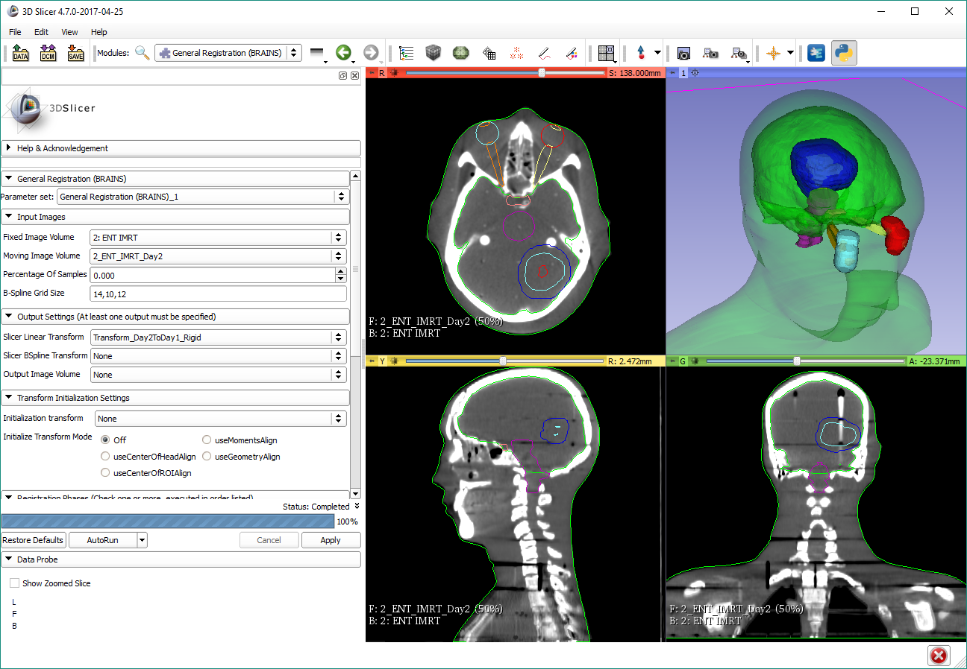
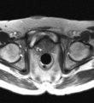
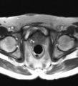
Registration
Manual: translation, rotation in 3D
Automatic: rigid, deformable, with various similarity metrics, initialization methods, optimizers, masking, etc.
Extensions: structure-based registration, Elastix, etc.
Notes:
As well as registration (which is the process of transforming different sets of data into one coordinate system, i.e. aligning images)
These are prostate MRI images, taken during MRI-guided robot-assisted prostate biopsy procedure; Slicer registers the high-resolution planning volume (acquired at the beginning of the procedure to plan biopsy targets) to the lower-resolution confirmation volume (acquired after the needle is inserted). The registration compensates for patient motion.

Slide 16
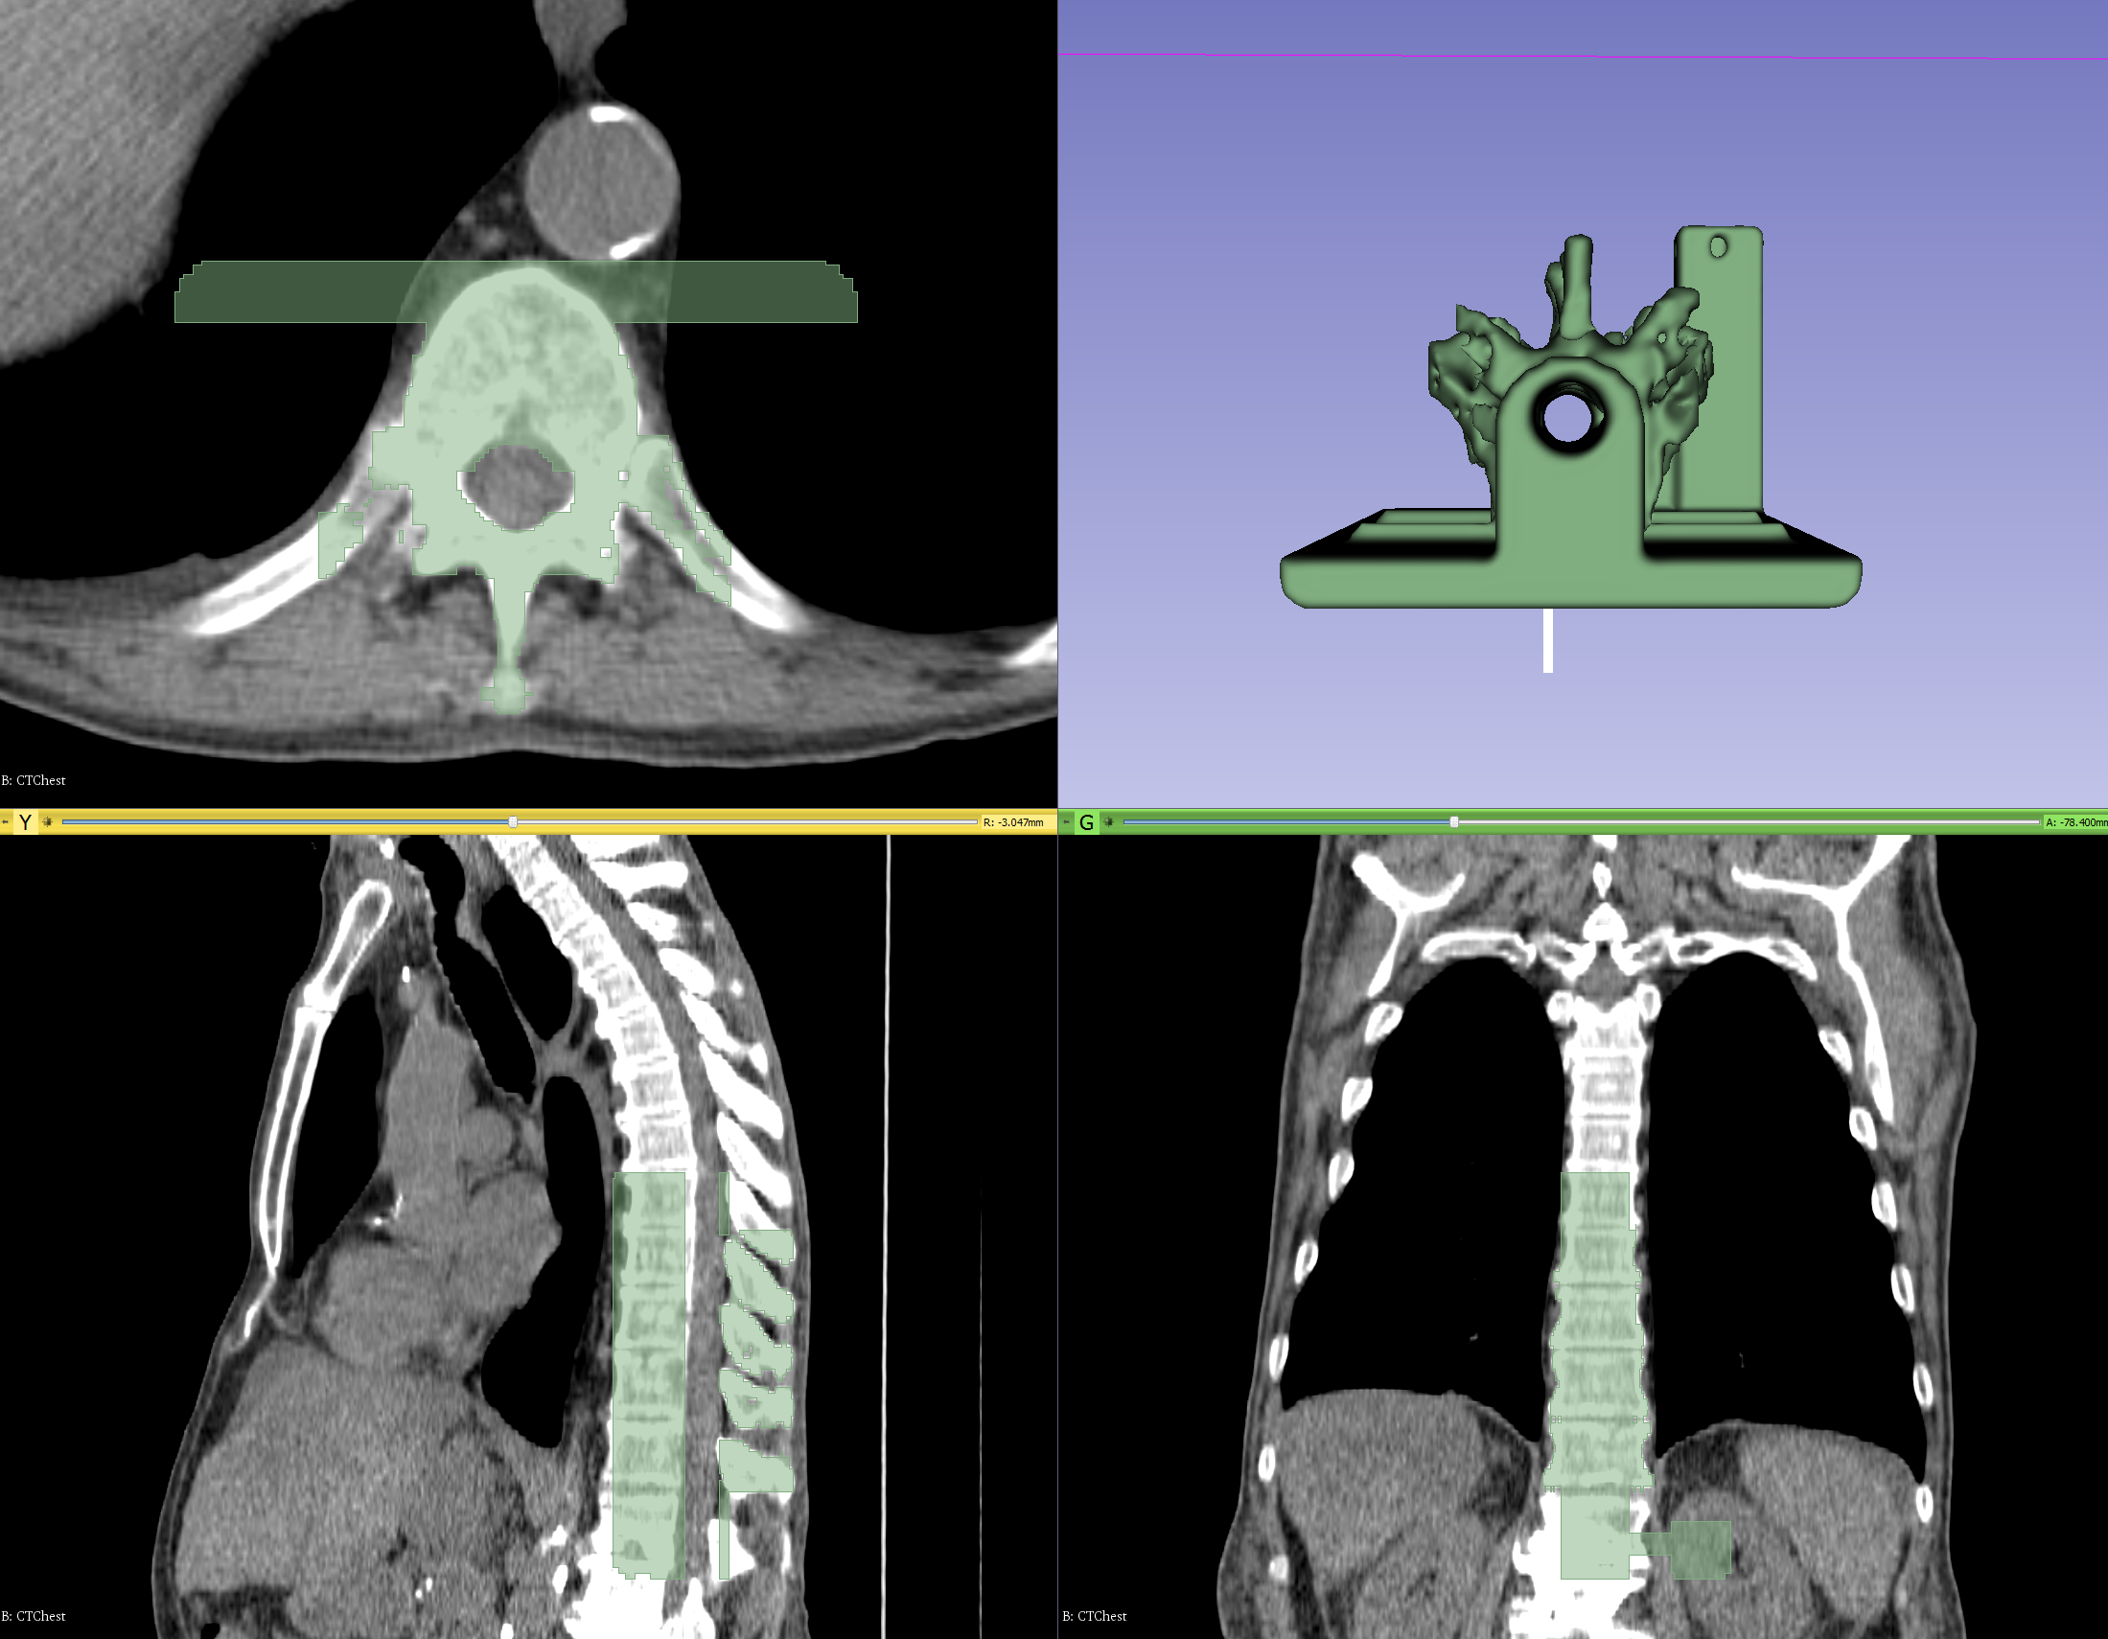
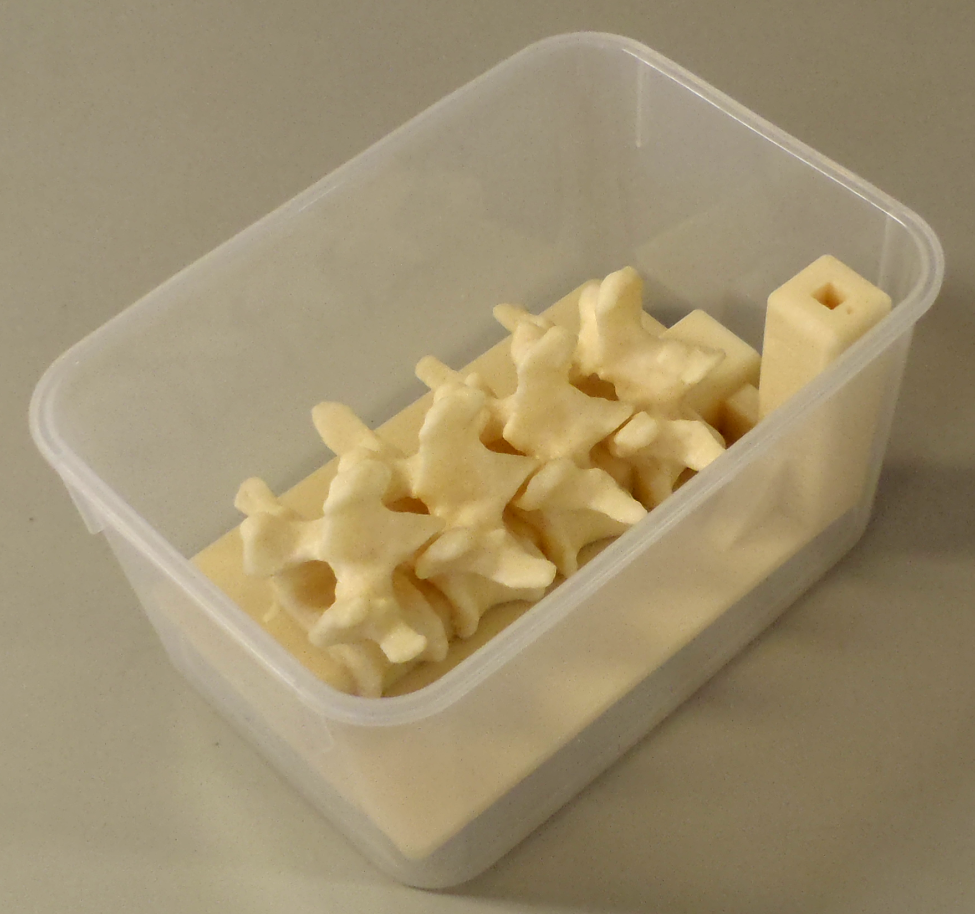
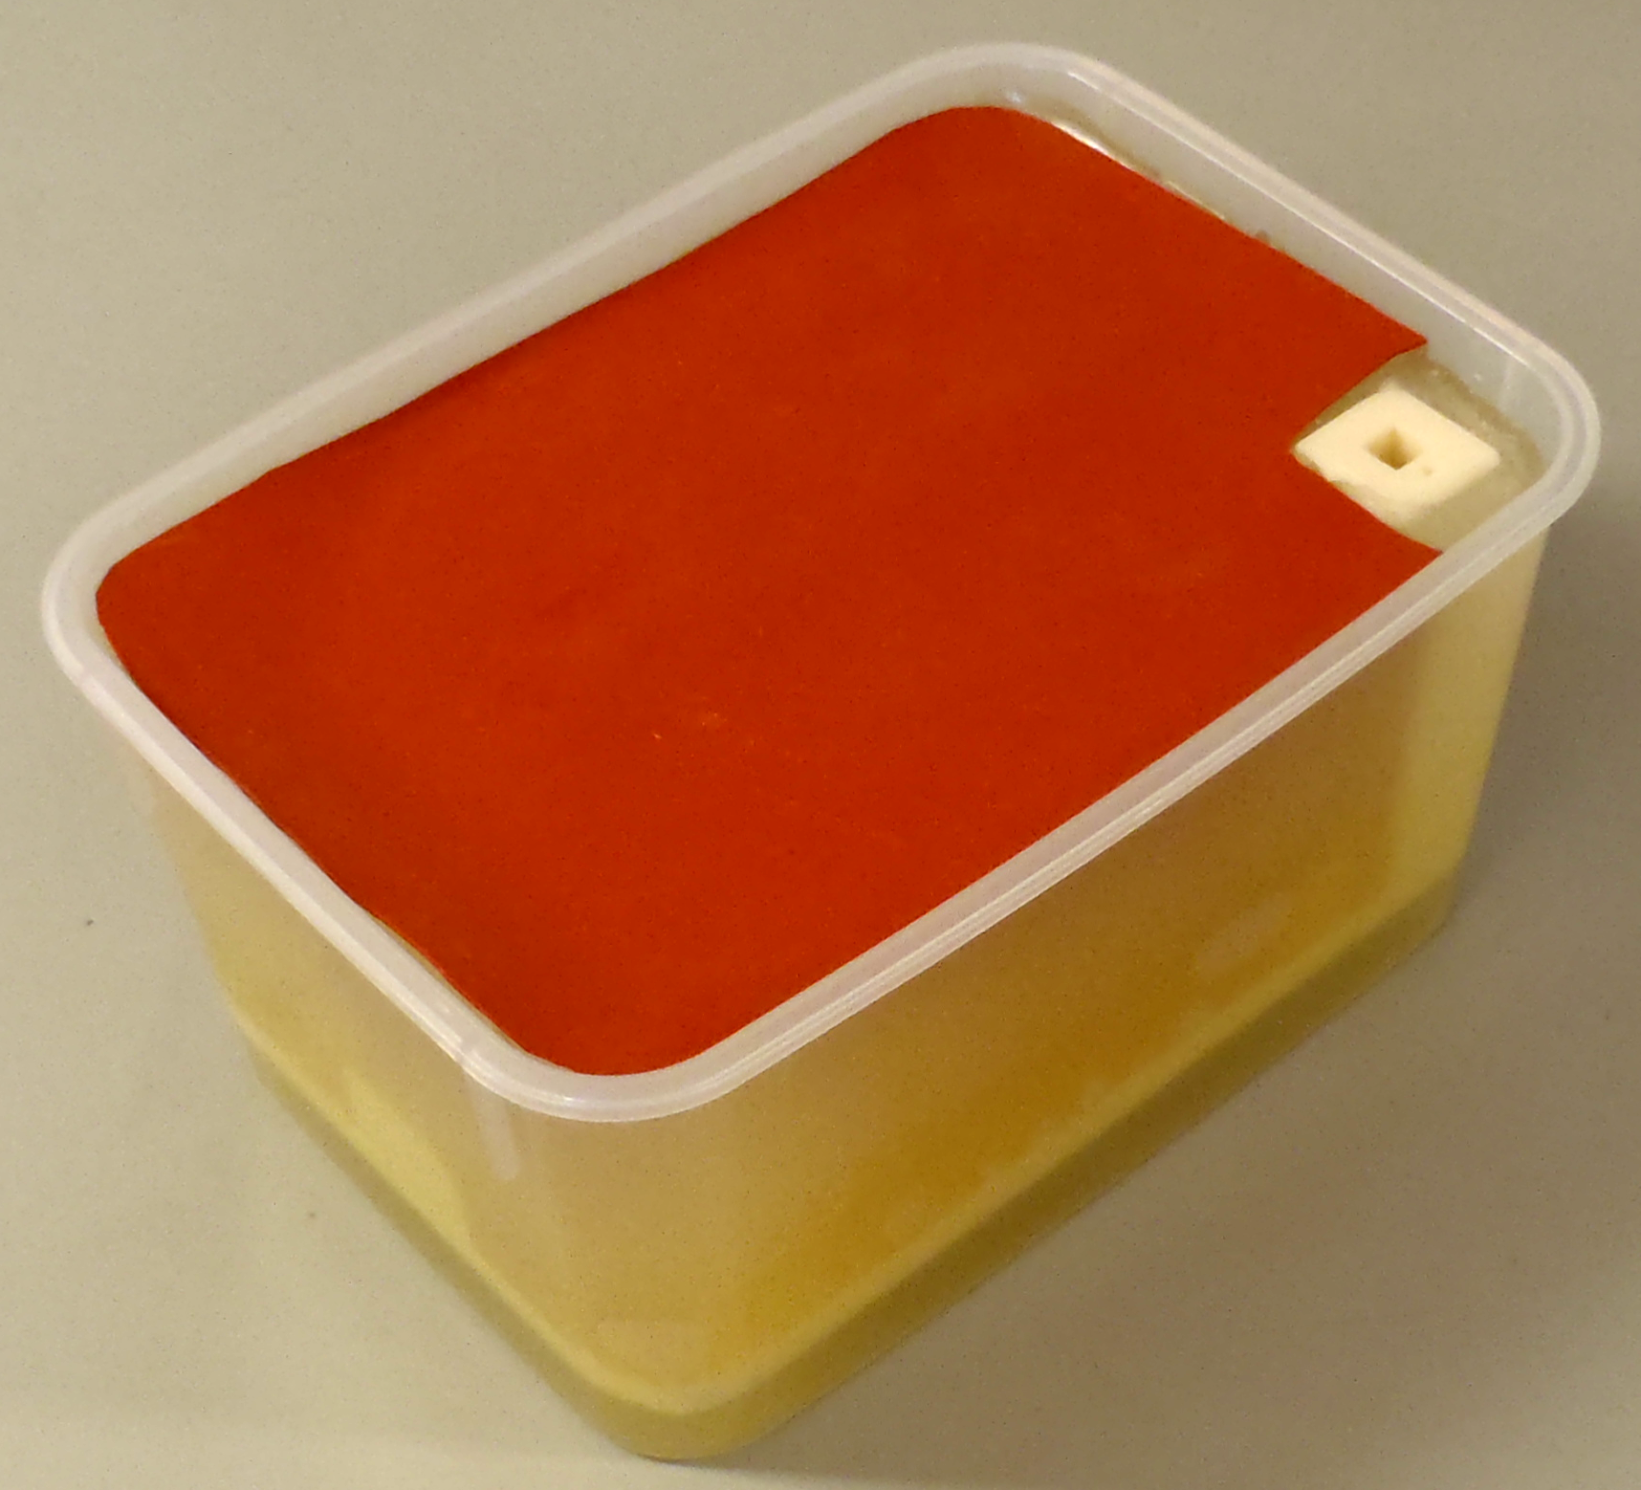
Segmentation
Manual (paint, draw, scissor, threshold, etc.)
Semi-automatic (region-growing, fill between slices, etc.)
Automatic (atlas-based, robust statistics, etc.)
Notes:
As for the common task of segmentation (which means to divide an image into multiple parts which is typically used to identify objects), Slicer supports both manual approaches (like contouring and painting) as well as automatic (like region-growing and atlas-based).
The Slicer screenshot here shows a segmented prostate in the Editor module where many of these tasks can be performed.

Slide 17
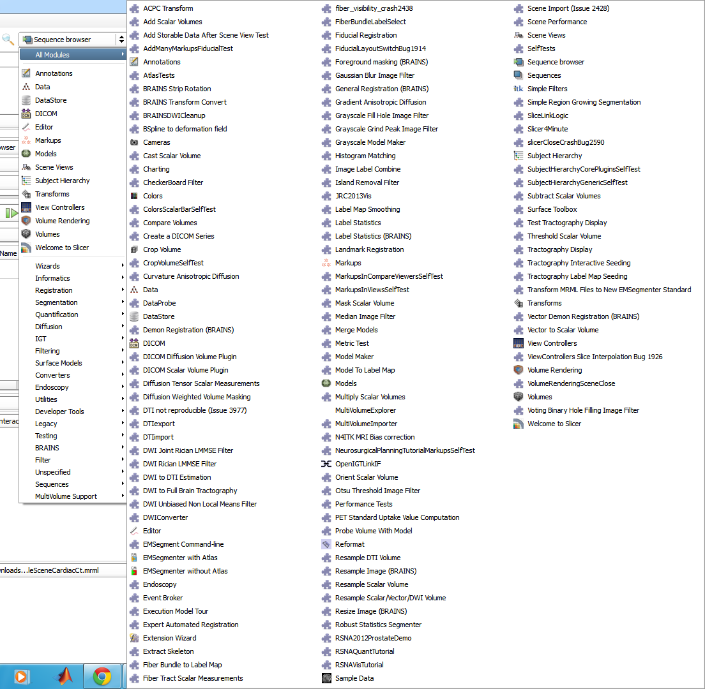
Many other modules...
Image filtering (image noise reduction, MRI bias correction, etc.)
Surface processing
Diffusion imaging
Quantification, statistics
...
Notes:
And many other modules are available by default, like for example: Informatics modules, for …; Filtering modules, for …; as well as many more.

Slide 18
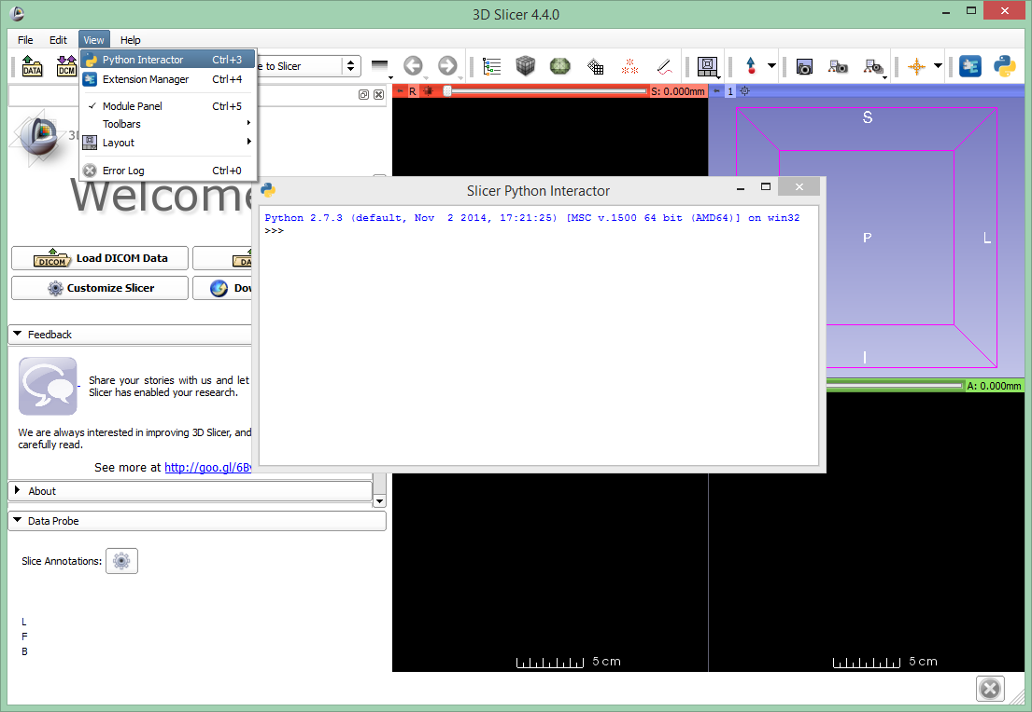
Python in Slicer
All data, processing, user interface elements are accessible from Python
Interactive console of Slicer gives access to all data objects and user interface elements
Any Python packages can be pip installed and used

Slide 19
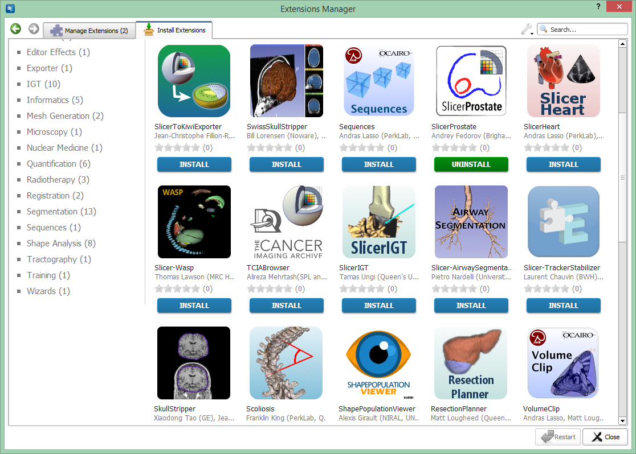
Slicer is extensible
The Slicer Extension Manager offers the possibility to the user to download and install additional Slicer modules

Slide 20
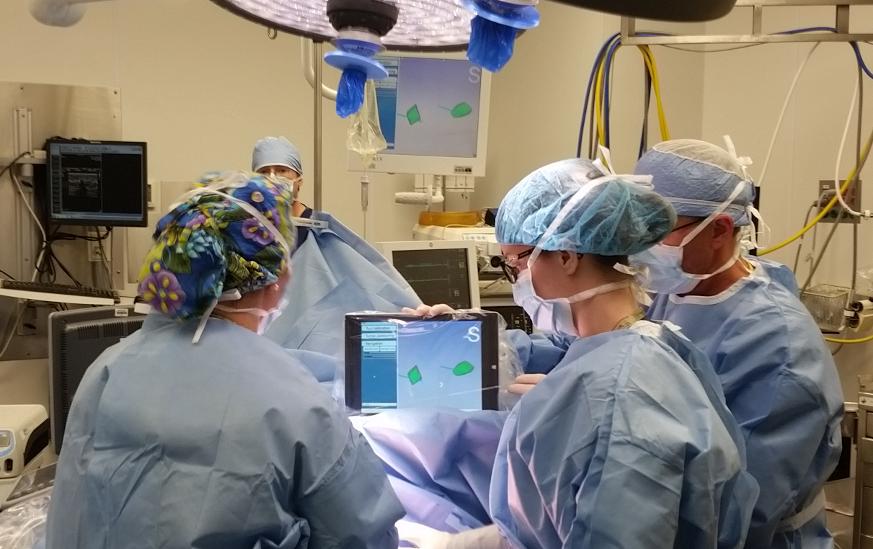
Major extension: SlicerIGT
Toolkit for image-guided therapy
Basis for navigation “guidelets”

Slide 21
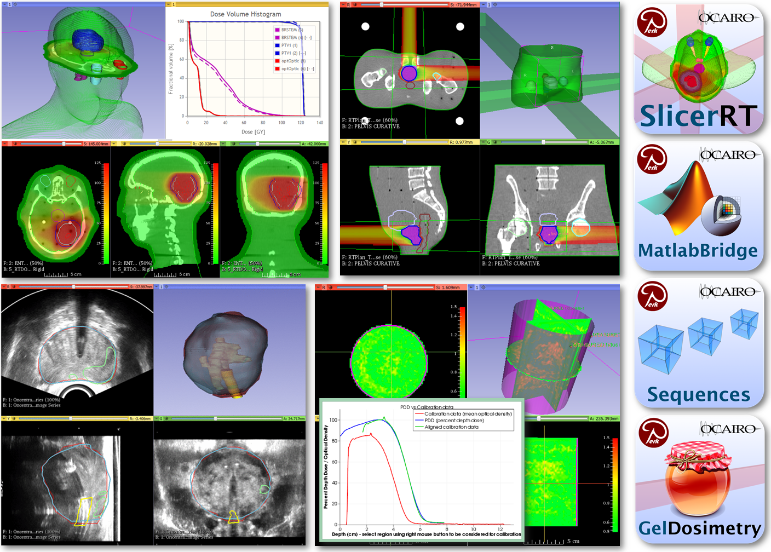
Major extension: SlicerRT
Toolkit for radiation therapy

Slide 22











Further notable extensions
PerkTutor
SegmentEditorExtraEffects
DebuggingToolsForExtensions

Slide 23
Slicer introduction tutorials
We recommend using the latest stable 3D Slicer version (Slicer-5.0.2) on all platforms.
https://download.slicer.org/
Usually after about 3 months it is better to switch to the latest Slicer Preview Release (due to the many available fixes and improvements). Goal is to create a new stable release every 3 months.

Slide 24
Tutorial sections
Visualization
load/save, sample data, viewers, models, volume rendering (30 min)
DICOM
tags, where to get them (web, TCIA browser), loading options, plugins, export
Segmentation
Segment Editor effects, workflows
Registration
BRAINS, Elastix, landmark registration, SegmentRegistration, transforms, transform visualization
Other: Sequences, Jupyter, MatlabBridge, Virtual reality

